Slide 1
Money Matters
Facilitator Training - Introduction

Slide 2
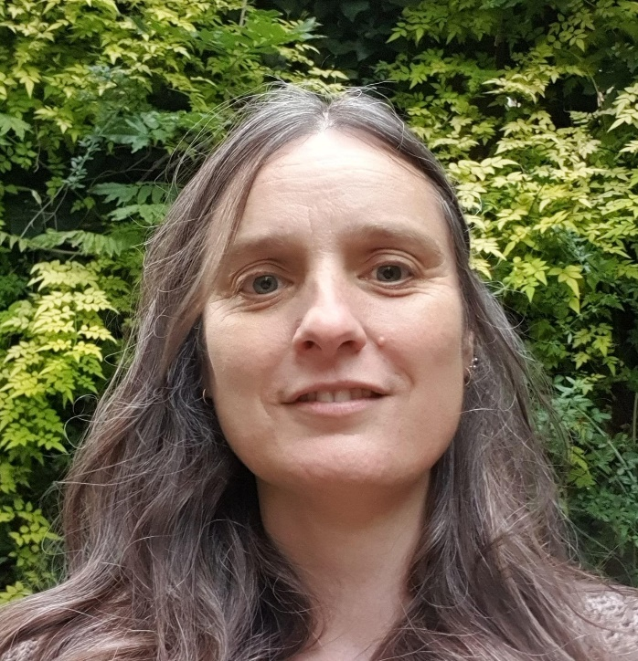
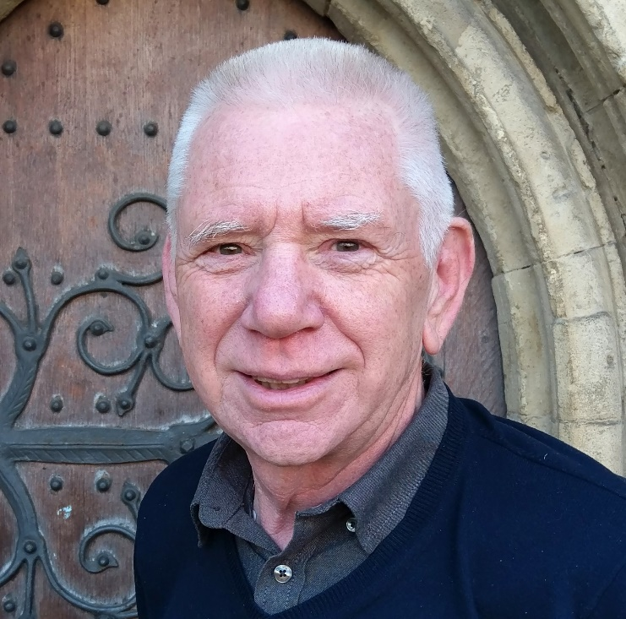
Welcome
Meet the Facilitators!
Magali van der Merwe CESA Team Lead
Keith Berry
Community Engagement Advisor
Notes:
Introduce the Facilitators and CESA team
Mention the wider work and the context for the money course
Explain this course is to train trainers to deliver the course materials to those in need of help

Slide 3
Moving forward after this course
The Diocese offer a number of support options for you moving forward to deliver the course:
Co-Delivery
Ongoing Support
Updated Resources
Notes:
If you deliver this moving forward, we can help you co-deliver to participants in your local area
We offer ongoing advice and guidance and constantly updated resources
Put your own logo on the slides if you wish, Place of Welcome, church etc

Slide 4
Introduction
Introduce Yourself to the Group
Who are you?
Where are you from?
Why are you taking the course today?
Remember: I am NOT a Financial Advisor!
All Sharing is Confidential
Notes:
Welcome everyone and go around the group, asking people to say who they are (as facilitator, it might be helpful to make a note of everyone’s name) and where they are from.
• Stress that what people share within the group is up to them.
• Say that they will not be asked to divulge any personal information to the group.
• Ask the group not to share anything confidential they hear
• Listen to each other
• Respect other people’s difference and opinions
• Try not to dominate
None of us will be financial advisors!!

Slide 5
Course Objectives
You Will Know…
Key Points on Income and Expenditure
How to Develop and Structure a Budget
How to Signpost to Relevant Organisations
Without Giving (Mis)Leading Advice
Begin to Understand Where to Signpost Individuals
Factoring in their Individual Circumstances
Notes:
These are the three main objectives of the course –
getting income and expenditure under control and accessing professional advice where needed

Slide 6
Info & Signposting (NOT Advising)
Issue | Giving Advice | Providing Info & Signposting
Behind on rent | You should tell your landlord that he can’t evict you anyway | It could be a good idea to speak to your landlord. To prepare for that conversation you could take a look at some of the resources on the Just Finance Foundation’s Coronavirus Help Hub or speak to Citizens Advice.
Notes:
This course does not teach you to be a debt or financial adviser.
You should at no point advise on debt or imply you are qualified to do so.
This course simply shares information and signposts individuals to relevant organisations.
Here is the first of two examples illustrating the difference between giving advice and providing information
Remember, you are willing – It is OK to share general factual information and ideas about managing and saving money.

Slide 7
Info & Signposting (NOT Advising)
Issue | Giving Advice | Providing Info & Signposting
Debt | You should stop paying the least important ones | If you are struggling to pay for your mobile or other bills, consider negotiating with the company to manage outstanding sums with a realistic payment plan. Independent and free organisations who are very knowledgeable about your options are available and willing to help, reducing stress. Citizens Advice, StepChange, National Debtline or Pay Plan
Notes:
This course does not teach you to be a debt or financial adviser.
You should at no point advise on debt or imply you are qualified to do so.
This course simply shares information and signposts individuals to relevant organisations.
This is the second example illustrating the difference between giving advice and providing information
Remember, you are willing – It is OK to share general factual information and ideas about managing and saving money.

Slide 8
Course Expectations
This Course is Informal – Have Fun!
Don’t Assume Knowledge
Just because something seems obvious to you does not mean it will be obvious to everyone!
Empower People to Make Their Own Decisions.
Email: Magali.vanderMerwe@rochester.anglican.org
Notes:
The material can be dry, make your presentation as engaging as possible
Focus on the issues of the individual, make sure you understand them, then make sure you concentrate on those particular areas during the course

Slide 9
Tailoring the course To Your Area
You Are the Expert on Your Community:
Add relevant projects, organisations & resources
Include Local Information – make it relevant to people in your area
Notes:
One thing we really want to encourage is the tailoring of the course to your local community.
You are all the experts your local area, you will be aware of where your local food bank is and what local responses and charities there are.
Use local information in your delivery as it can really transform the way the course is presented

Slide 10
End of Facilitator Training Slides
Notes:
Now move on to taking the participants through the course material that they will have access to.
Load Session 1

