Slide 1
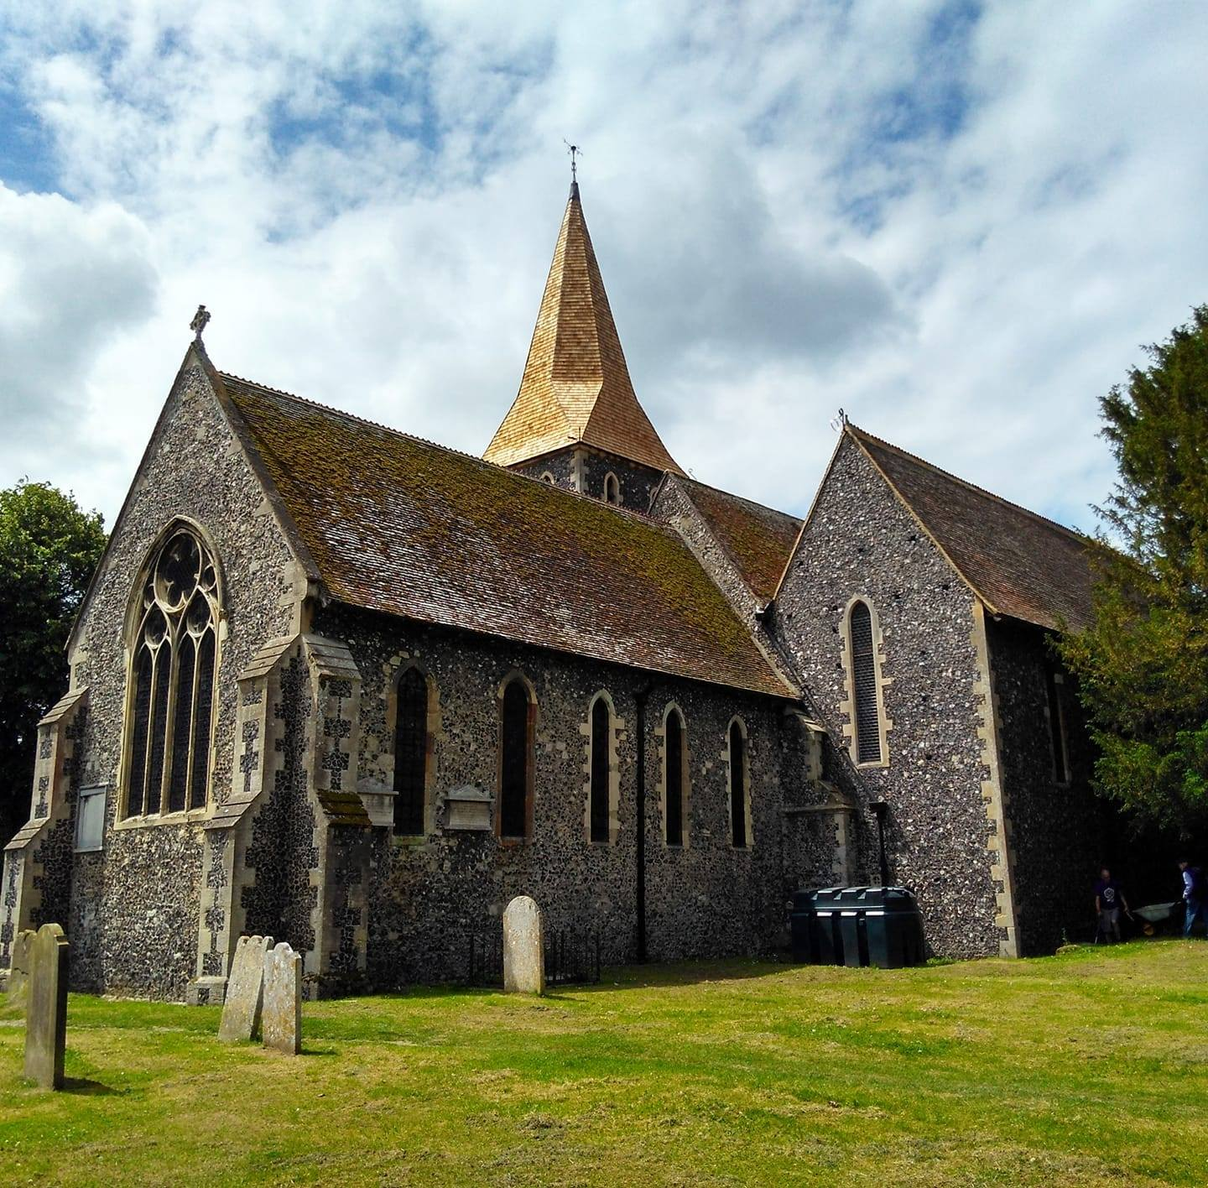
St Augustine’s Church
Anywhere
Notes:
Welcome to church this morning.
Talk about generosity – everything we have comes from God. Not just our money, but time and talents, the world around us our family and friends.
It is our responsibility as Christian disciples of Christ to recognize these gifts, to nurture them, and say ‘thankyou God. I would like to give some back to you’.

Slide 2

Notes:
It is important to acknowledge the gifts of money, time and skills that we receive from members of our church. We all like to feel appreciated.
We often take people, and all the things they do for granted – so thank you! Without your generous, regular giving and contributions of time and skills, and those of people who have gone before you, our church would not be here today.
Thank you!

Slide 3
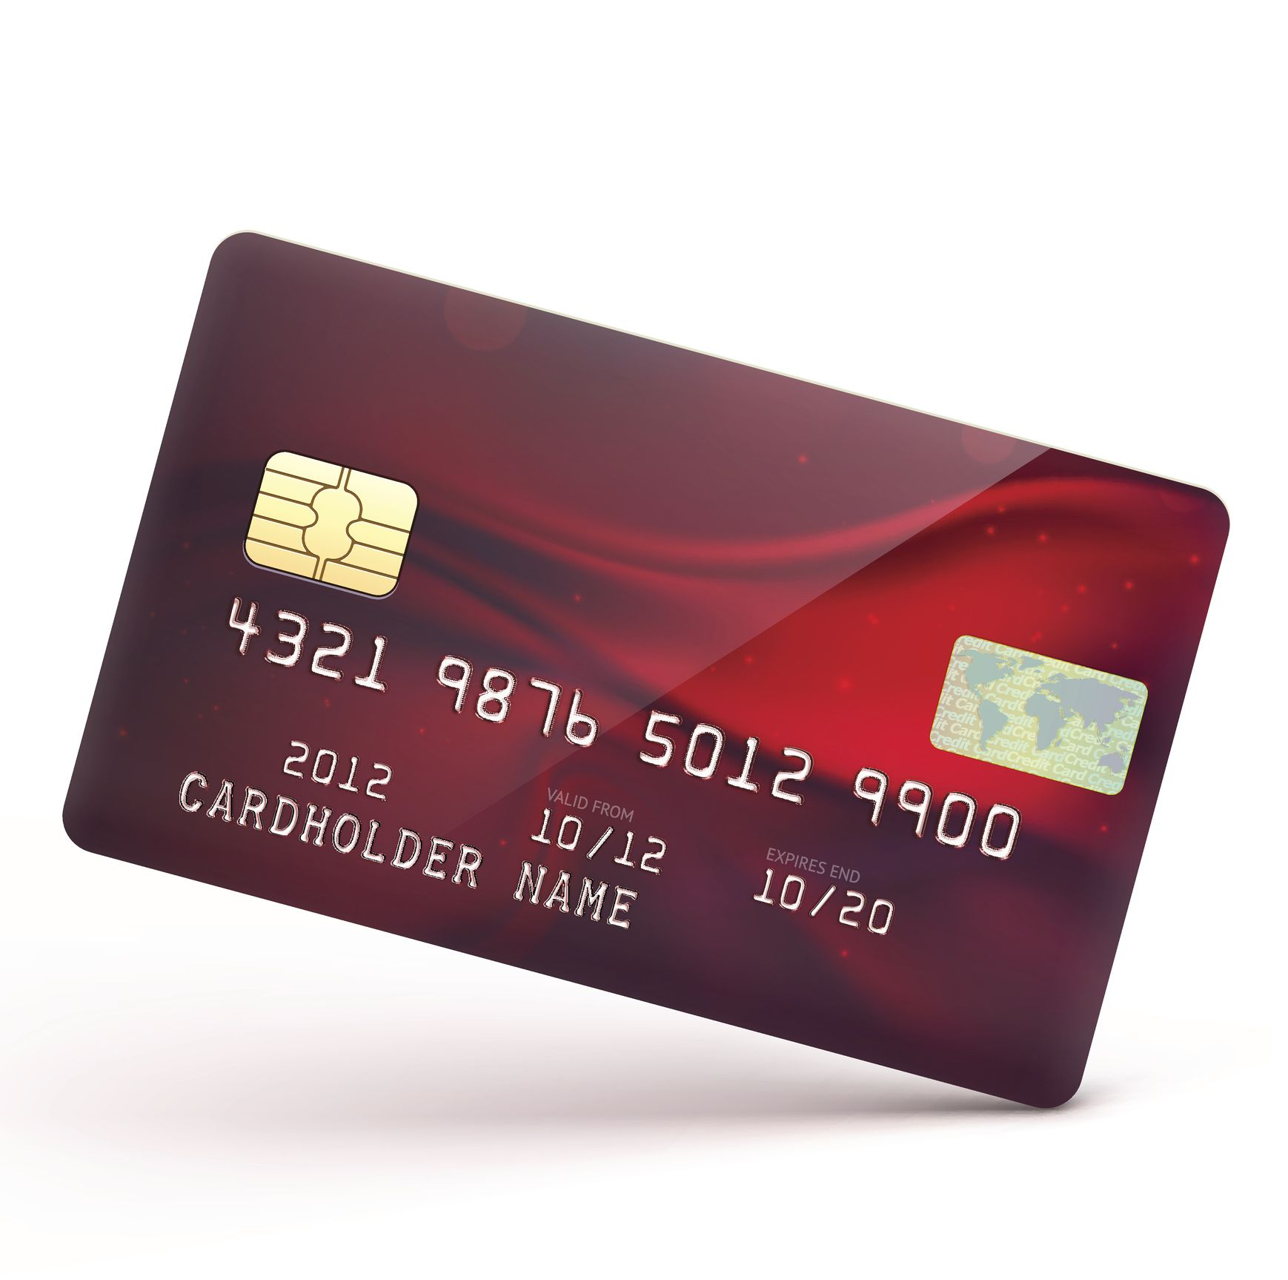
What about the money?
Notes:
We are looking at the financial aspects of our giving today.
We don’t receive and funding from the Church of England or the government and the responsibility for paying for our church running costs and vicar falls entirely on us.
Money is important. It funds our clergy and their ministry, which we value, and the mission and outreach which that ministry enables.

Slide 4

St Augustine’s £XXX per month to run this year.
Notes:
When looking at now much it costs to run the church you can use weekly or monthly figures.
Most people’s income comes monthly, so monthly figures match up with that. However, if your church is looking at a big deficit weekly figures might work better. If you say we have a shortfall of £20,000 a lot of people will think it is unachievable and not even try. If you say, however that we need an average of £3.50 per head per week to break even, that’s less than the prices of a medium cappuccino at Costa Coffee (or whatever is appropriate to your context), it will look much more do-able.

Slide 5
Each month we spend £XXX
Salary, admin & ministry expenses £XXX
Church running costs £XXX
Common Fund £XXX
Fabric maintenance & repair £XXX
Charity/mission giving £XXX
Sundries £XX
Total £XXXX
This is just the everyday running costs
Notes:
We don’t need too much detail here – this is meant to be broad brush. For most churches Common Fund is the biggest expense.

Slide 6
What is the Common Fund?
Notes:
May people in many parishes see the Common Fund as a tax which goes up to ‘the Diocese’, never to be seen again. Nearly 80% of the Diocese of Rochester’s funds come from Common Fund. This bar chart show where the money goes. You can see that the biggest amount is the cost of incumbents, curates and ordinands.
Parish support costs includes things like education, DAC, safeguarding and admin.

Slide 7
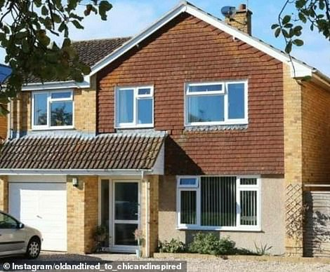

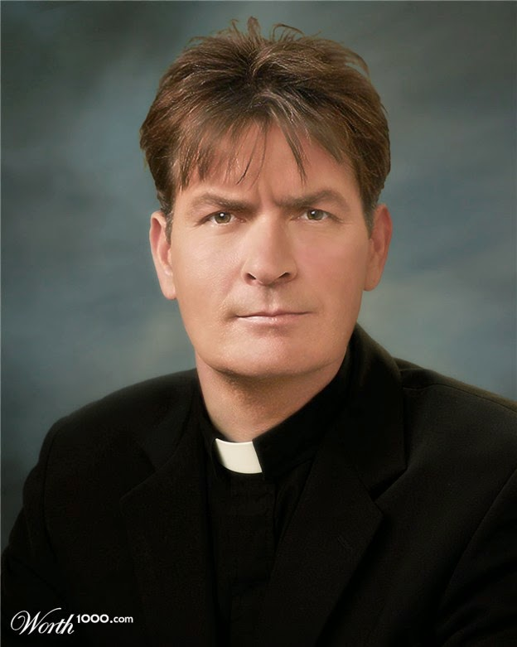
Ministry costs - £45,198
Notes:
The cost of ministry is more than stipend – there’s housing and all the costs associated with that and pensions, as well as ongoing training.

Slide 8
Our monthly income
Planned Giving
(standing orders/envelopes) £XXX
Gift Aid £XXX
Digital giving £XXX
Cash collections £XXX
Fundraising income £XXX
Rental & trading income £XXX
Other £XXX
Total £XXX

Slide 9
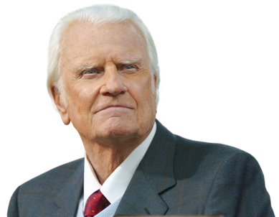
What about our money?
Notes:
Let’s forget for a moment our Church and what is needed and think about our own finance.
Billy Graham described a cheque book as a theological document, because nothing shows where our priorities are, or illustrate our values as much as where we put our resources.

Slide 10



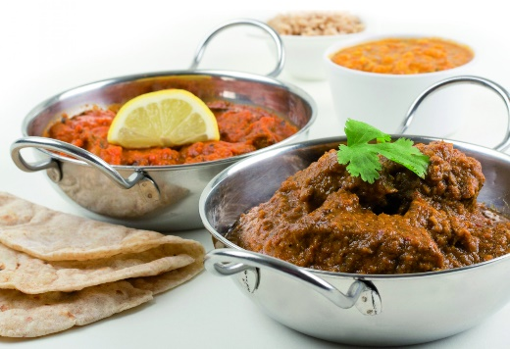
What do we spend money on?
Notes:
How does what you give to the Church relate to other things you spend money on – often without even thinking about it?
You may not spend money on all of these things – or any of these things, but we all what we regard as a lot of money has a lot to do with how much we value it.
You may do yoga, or another fitness class, for example, and really value it – how does that compare with what you give to God?
Where on your list of priorities is your faith? Is it as important as that lovely meal in a restaurant, or a new book?
All of this is particularly relevant right now, with the cost of living crisis, but are you prepared to think about it, pray about it and make changes is you can?

Slide 11

PRIORITY
Notes:
There are three ‘Ps’ here:
How important is God in my life? In him do I live and move and have my being? Do I recognise that everything I have comes from God and when I give back to God I am only giving what is his anyway?
When I am juggling all the balls in my life – all the competing demands and I’m about to drop one, is will it be the God ball I drop, or will I try and hang on to that one?
Or is God that thing I do on a Sunday morning and forget for the rest of the week?

Slide 12

PLANNED
Notes:
The second ‘p’ is about planning.
When it comes to money and finance we generally have a fairly good idea of where our money goes. We plan and budget. We know that the insurance is likely to rise each year, and we take account of that. We know how much we will spend on food and entertainment.
If we don’t our finances are likely to be a mess.
When we plan how to budget our resources do we think about God? Do we plan and budget? And just as we pay the gas and electricity by direct debit, do we have a standing order to give to God in an orderly, intentional way?
Many member of this church give each month by standing order. Would you consider joining them?

Slide 13
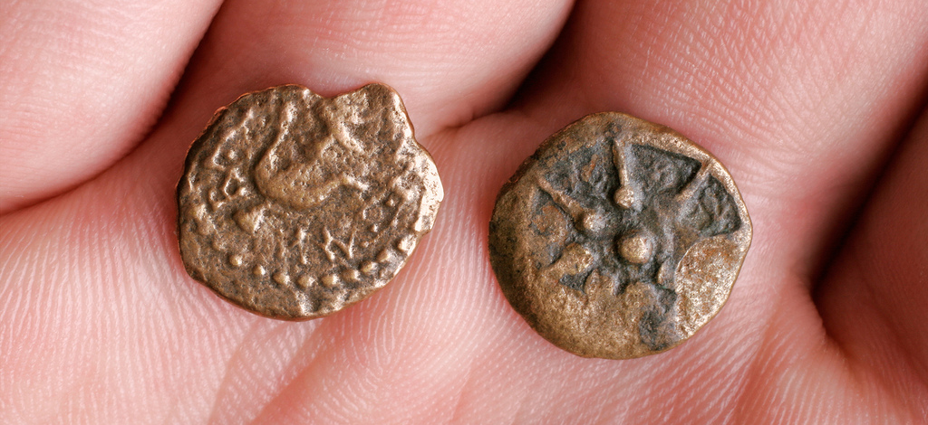
PROPORTION
Notes:
The third ‘p’ is about proportion.
Some churches teach and preach on tithing, and for many people that is the right thing to do. However all of our circumstances are different and I am not here to tell anyone how much they should be giving to God through his church.
I do ask you to think about it though. Work out how much you give now as a % of your income. Is that the right amount for you? Sometimes what feels like a generous gift turns out to be a very small % of our income. More Pharisee than widow.

Slide 14
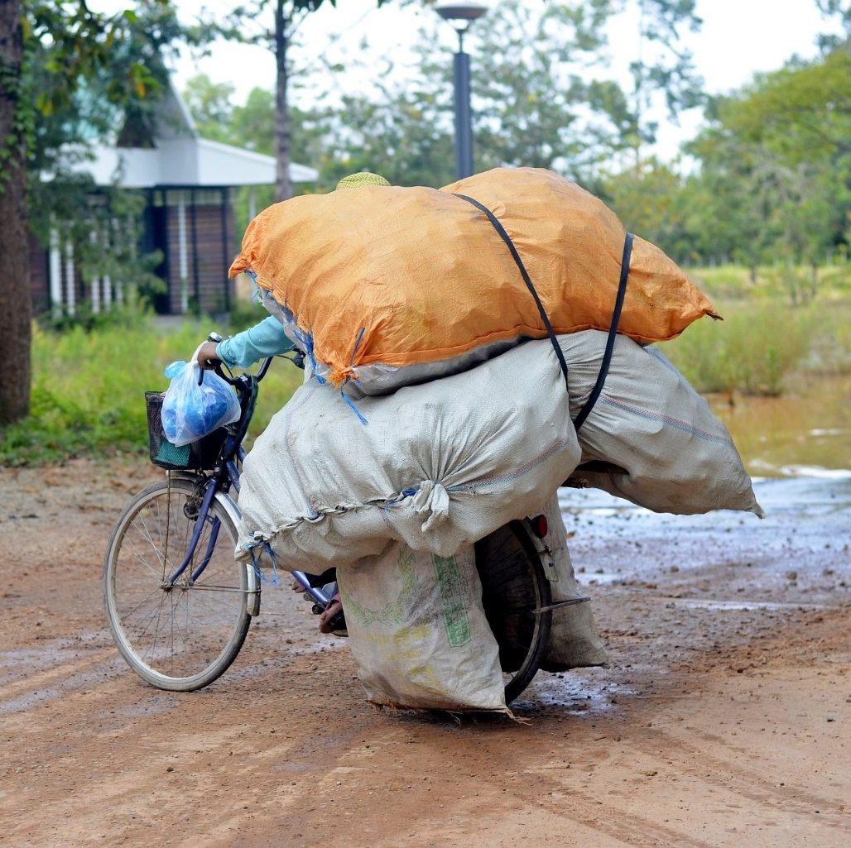
What we give is between us and God
How much should we give?
Significant
Sustainable
Notes:
We aren’t telling you what to give here – it’s completely up to you, but we do urge you to pray about it, think about it and talk about it with your family as you review what you give now.
No one’s business but yours and God’s.
It’s important that you don’t give more than you can afford, because you won’t be able to keep it up, if that’s the case.
Some of you may have retired, been made redundant or had a difficult pandemic – it’s absolutely fine to reduce your giving if you have to or want to
Equally, if we really believe in a generous God, who gave his only son that we might live, I think it should be enough that we notice.

Slide 15


How much?
Notes:
There will be many people in this church who are really struggling – some will have been suffered in the pandemic or made redundant, energy costs have really hit us all, or simply dealing with big mortgages and small incomes. Nobody expects these people to struggle even more.
There will be others, however who are much more comfortable and could easily do more.
If you went into a café with a friend and realised that friend couldn’t afford a cup of coffee would you drink yours in front of them, or would you offer pay for theirs?
It’s all about balance, proportion and ultimately love and care for one another.

Slide 16

Two things
Notes:
Now here’s the practical bit.

Slide 17

Review our financial giving
Join planned giving
Notes:
Please think and pray about what you currently give now. What proportion of your income do you give now? Can you increase it by 1% or 2%? Or more than that?
We cannot expect an equal amount from each person
We can expect each person to make an equal sacrifice
We can expect each person to budget for a sufficiently generous give to indicate that God has priority in their lives

Slide 18

Introducing…..
Notes:
We have joined the Parish Giving Scheme
If you don’t already give by standing order this is the best thing you can possibly do to help our finances, and if you give by standing order already it would be great if you could make the switch
This is really easy to do if you do internet banking, but we can provide a paper form if you prefer.

Slide 19
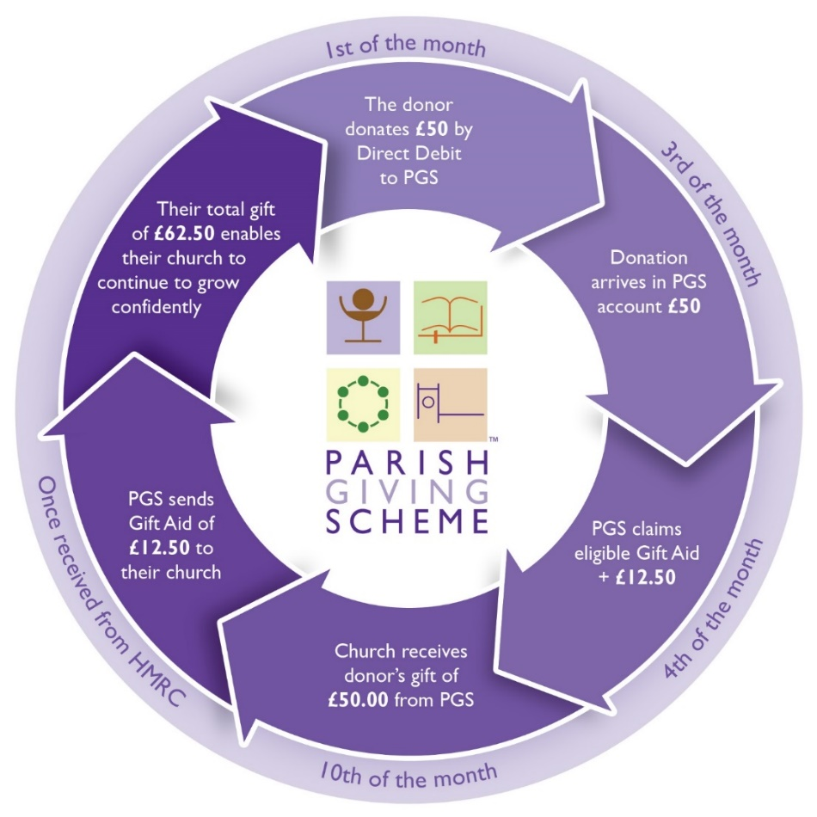

Parish Giving Scheme
Notes:
Donor signs up online, by phone or with a paper form.
Direct debit goes out on the 1st of the month. PGS remits the money to the church by the 10th of the month, processes the gift aid and remits to the church as soon as it is received

Slide 20

Benefits
Annual Inflationary Increase
Gift Aid
Gifts can be anonymous
Can reduce admin for treasurers

Slide 21

Please sign up!
Notes:
There is an information leaflet for donors available from the diocesan giving adviser liz.mullins@rochester.Anglican.org

Slide 22
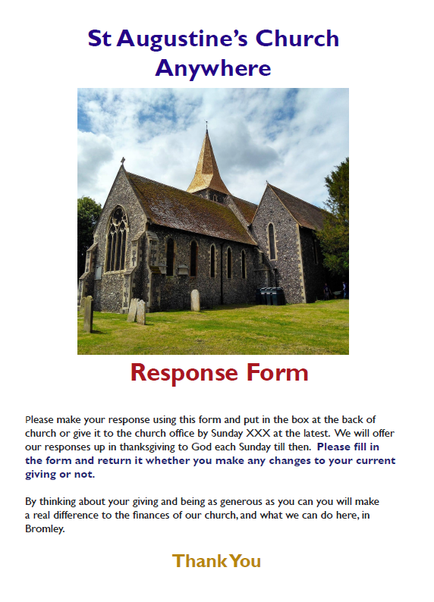
What next?
Notes:
We will give you a brochure which will summarise what I have said in this presentation.
We are asking every member of our church to think carefully how to respond, and to do so by 3 October. You can easily set up a standing order online, but we will let you have a paper form if you prefer..
This presentation and all the other materials will also be on the church website.
Thank you.

Slide 23

Why is this important?
Notes:
Because God loved the world so much he sent his son to die on a cross so that we might be saved. Our children are precious. So that shows just how generous God is, that he would give his own son to us.

