Slide 1
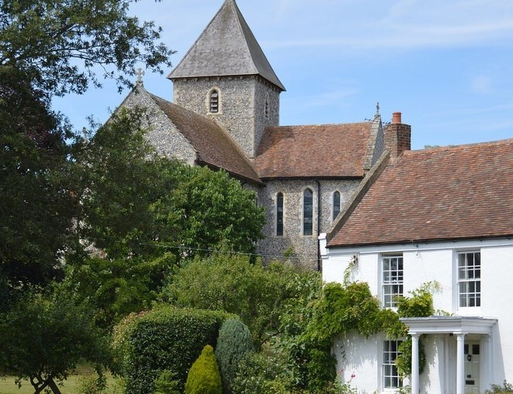
St Mary’s
Anywhere
Notes:
Let’s begin by thinking about what God has given to us
He’s given us everything – the world around us, our families, and our friends
He has made us all – and made us in his own image, which is a great gift.
He has also made each one of us different – each completely unique, with our own special gifts and talents, and that makes each one of us special
fundamentally stewardship is about looking after what God has given to us – whether it is the environment, or our church, or nurturing our own gifts to say thank you and to respond to God’s generosity by giving something back.
So you see that stewardship is a very broad idea – it does include our financial resources and how we use them for God and the Church, but that is only one part of a much bigger picture.

Slide 2
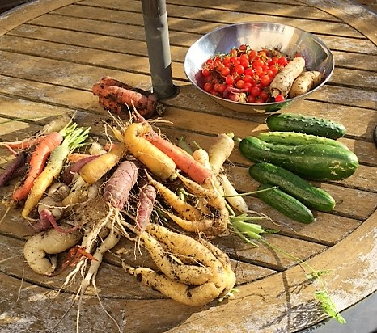
God is generous

Slide 3

Thank you!
Notes:
Many of you give enormously generously. Of your time, skills and money. Thank you. Without your contribution ouyr church would not be khere today.

Slide 4
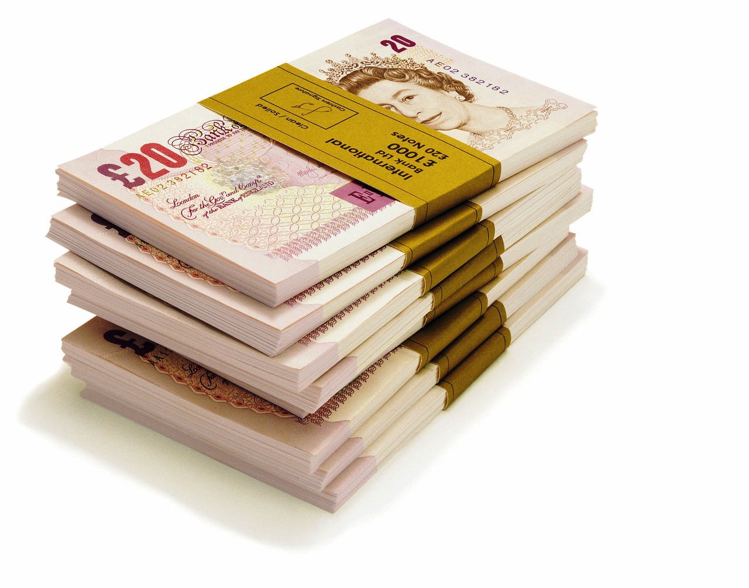
What about the money?
Notes:
Money isn’t important for it’s own sake – it is important because it resources the mission of the church and the ministry which supports that mission

Slide 5

It will cost
£000 to each week
to run
St Mary’s
in 2020.
Notes:
A lot of us feel a bit uncomfortable talking about money – especially in the context of church. How many of us try to drop money into the collection without anyone seeing just how much we are putting in?
It’s OK to talk about money though – 50% of Jesus teachings talking about money – think of the parable of the talents, or Zaccheus, or the Widow’s Mite – and I guess if it is good enough for Jesus, it’s OK for us to talk about it as well.
So – this is how much it is costing at present to run our churches?.
This looks like a lot, even though we control our costs tightly.
So where does it all go?

Slide 6
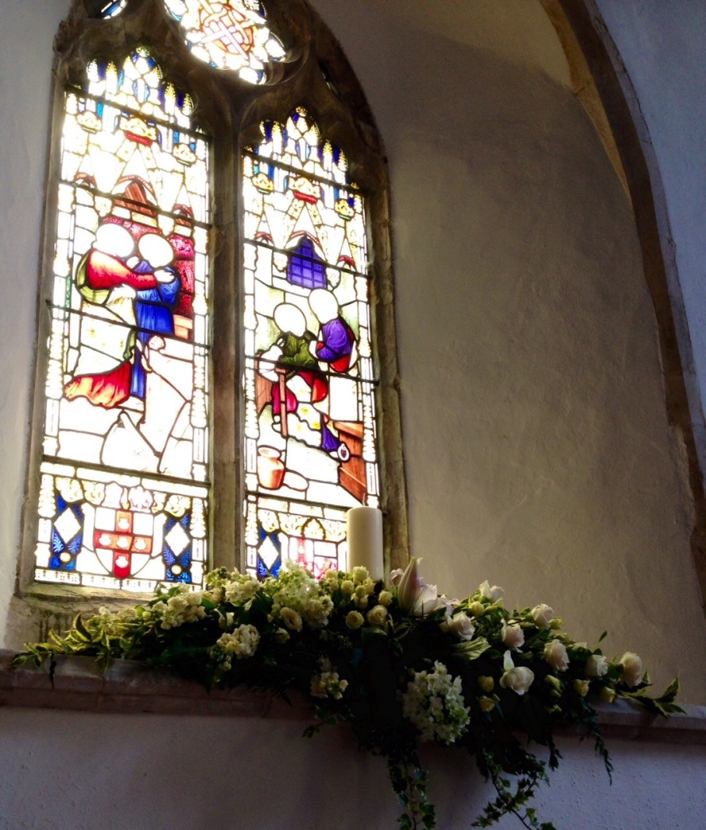
Here’s where it goes …
Clergy expenses £000
Insurance £000
Services £000
Utilities £000
Parish Share £000
Notes:
These figures represent our normal housekeeping costs, which will inevitably rise each year.

Slide 7
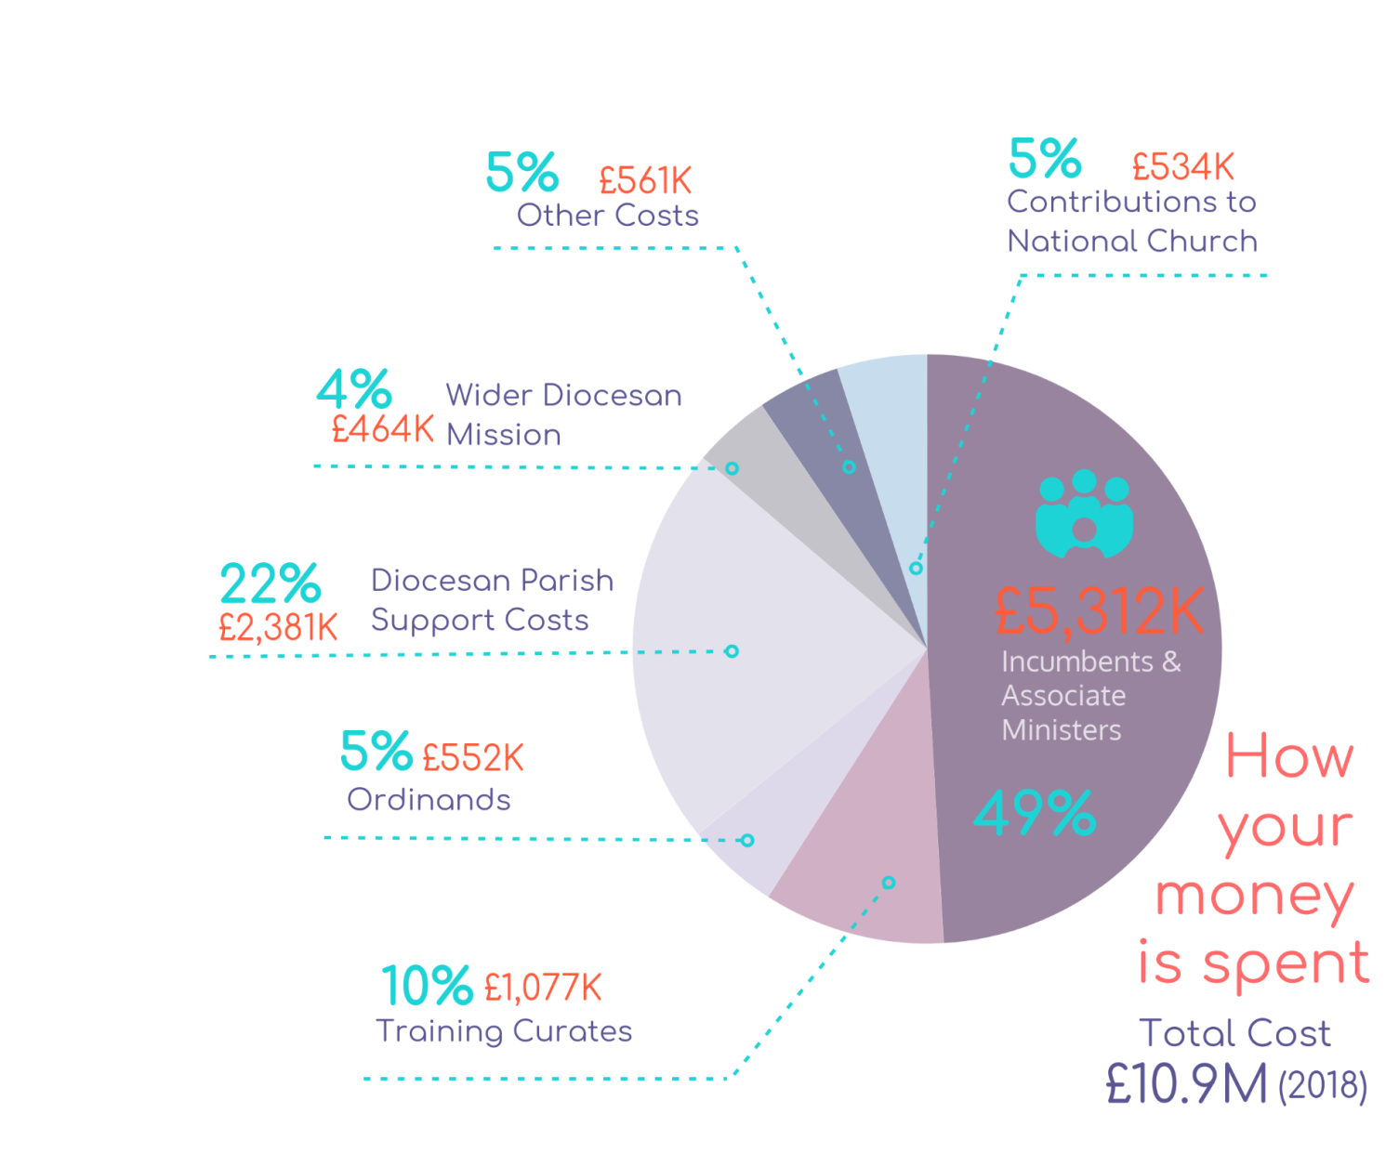


How is your money spent?
Notes:
Our biggest single expense is our contribution to the Common Fund. We offer our money to the Diocese to fund the ministry of God’s church in this part of Kent. This is how the Diocese spends that money.

Slide 8
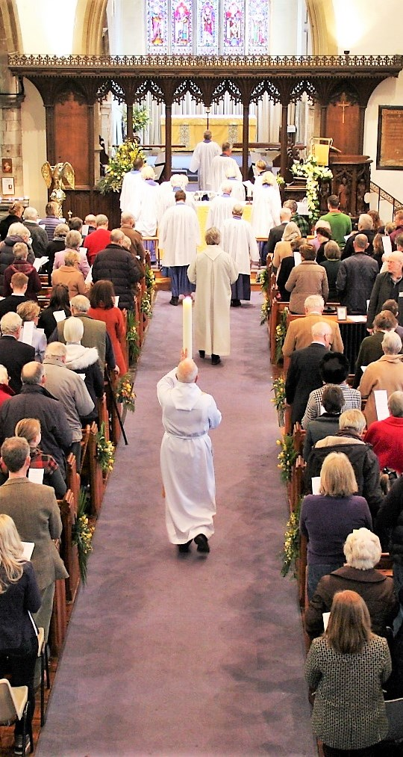
Where did it come from?
^{Giving £000}
^{Gift Aid/interest £000}
^{Fundraising £000}
^{Fees/hires £000}
^{Total} ^{£000}
Notes:
Most of our money comes from your generous giving. Thank you.

Slide 9
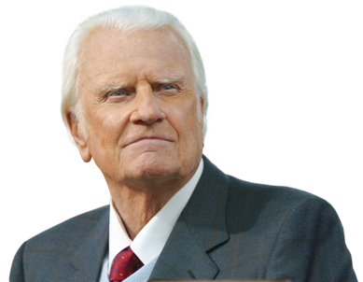
What about our money?
Notes:
Billy Graham described a cheque book as a theological document.
There is nothing which shows what’s important to us more than where we spend our money.

Slide 10
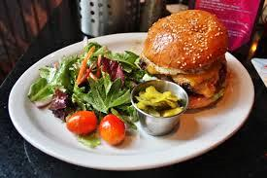
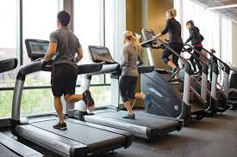

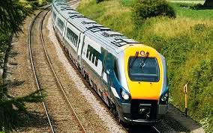


What do we spend money on?
Notes:
How does what you give to the Church relate to other things you spend money on – often without even thinking about it?
You may not spend money on all of these things – or any of these things, but we all what we regard as a lot of money has a lot to do with how much we value it.
You may do yoga, or another fitness class, for example, and really value it – how does that compare?
Etc etc
£20 note – it’sk not much when you go to the supermarket. However if I ask you to put £20 into the Sunday collection it suddenly becomes a lot of money.
Where on your list of priorities is your faith? Is it as important as that lovely meal in a restaurant, or a new book?

Slide 11

PRIORITY
Notes:
Think of our giving in three ways:
How important is God in my life? In him do I live and move and have my being?
Because if God is important to me, my giving to God will also be important.

Slide 12

PLANNED
Notes:
If God is a priority I will have thought about what is right for me to give. I will have planned it.
I will probably also have set up a standing order so I don’t have to find cash every week.

Slide 13
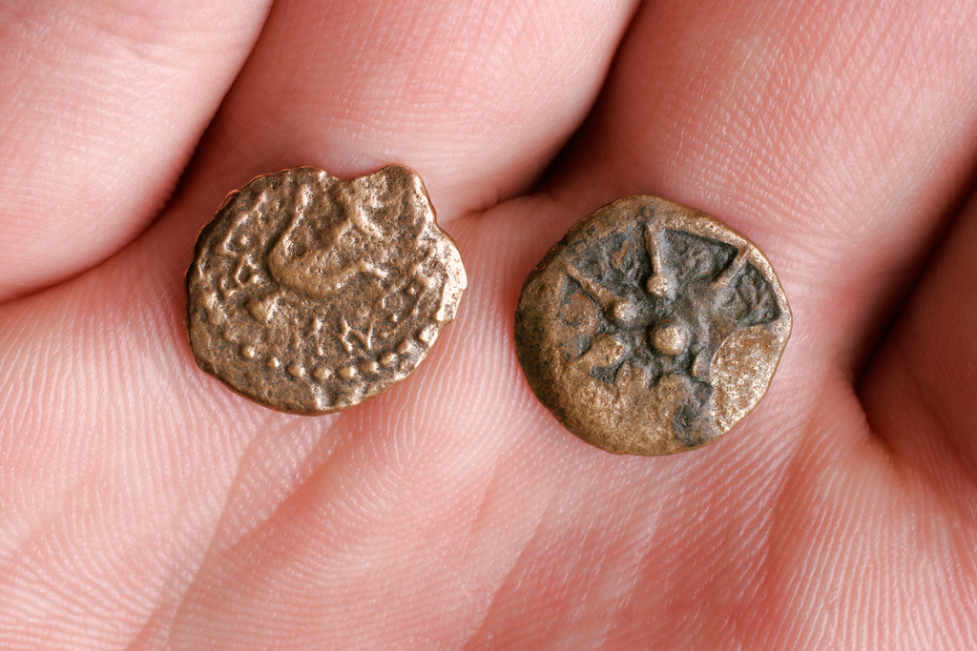
PROPORTION
Notes:
We might want to think about tithing – giving 10% or our income to the church, but that is up to us.
Since the 1070s the Church of England has asked that we think about giving 5% to the church, which will leave another 5% to go to other good causes.
Work out how much you give now as a % of your income. Is that the right amount for you?
Think about the widow’s mite – and how generous that woman, who had so little was.

Slide 14
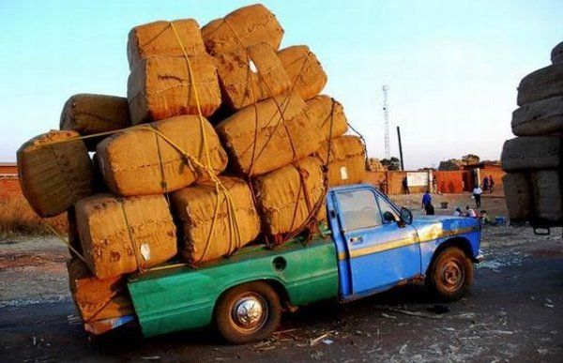
What we give is between us and God
How much should we give?
Sustainable:
not more than we can afford
Significant:
enough of our income to make a difference
Notes:
We aren’t telling you what to give here – it’s completely up to you, but we do urge you to pray about it, think about it and talk about it with your family as you review what you give now.
No one’s business but yours and God’s.

Slide 15

How much?
Notes:
People may say that no-one has any money, but we know that others are much better off. If you went into a café with a friend and that friend couldn’t afford a cup of coffee would you drink yours in front of them, or would you pay for theirs?

Slide 16
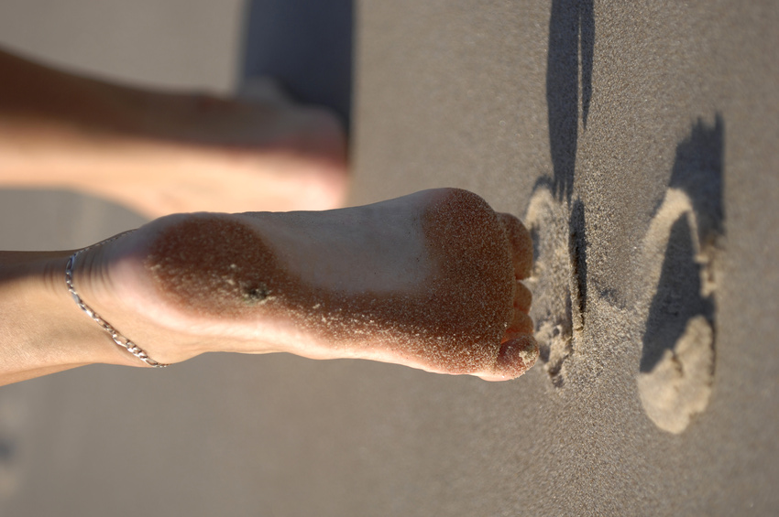
The Next
Step….
Notes:
Now here’s the practical bit.

Slide 17

What next?
Review our financial giving
Join the planned giving scheme
Sign up for Gift Aid
Notes:
We cannot expect an equal amount from each person
We can expect each person to make an equal sacrifice
We can expect each person to budget for a sufficiently generous give to indicate that God has priority in their lives
Please think about what you give now. Could you give more? What % do you give now? Could you increase by 1%?
If you are not already part of the planned giving scheme – and most of our congregation are – please do so. It will make a huge difference to your church’s income, and we can budget better, knowing how much is coming in each month.
If you pay tax in the UK and haven’t already signed a gift aid declaration please do so now.

Slide 18
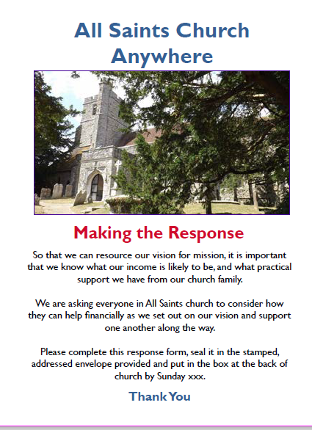
Please complete the response form by 16 December
Notes:
Please respond, even if you don’t change what you currently give at all.
Your responses are confidential – only xxx knows who gives what.
We would like to have these responses in by xxx date, and someone will remind you if you don’t – so please expect a call!

Slide 19
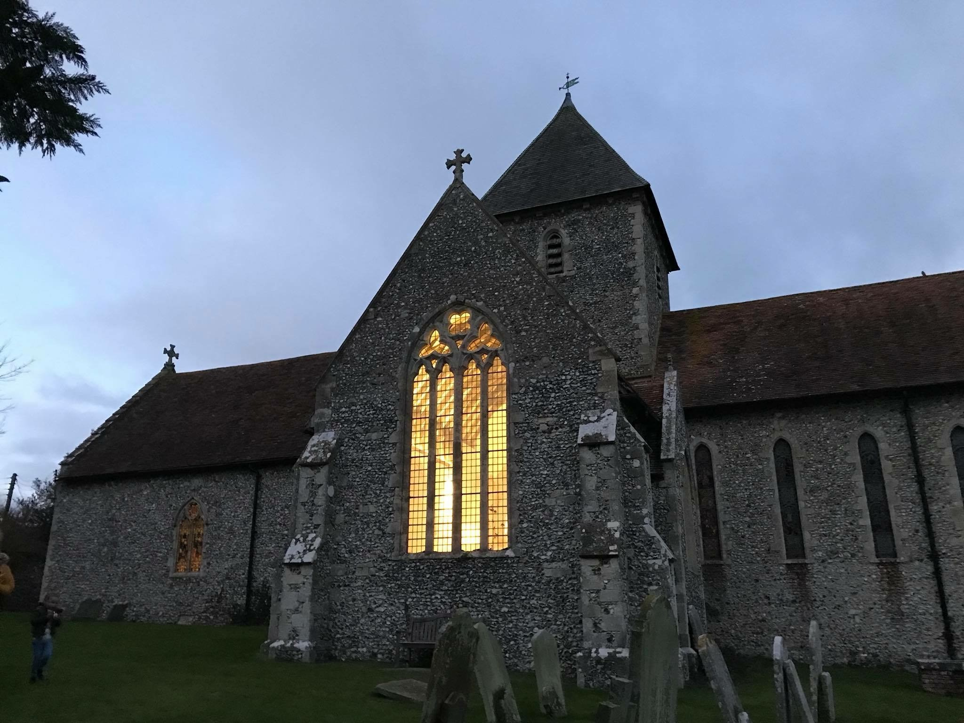
Were the whole realm of nature mine,
That were an offering far too small;
Love so amazing, so divine,
Demands my soul, my life, my all.
Notes:
So that’s basically it
You now know what comes in and what goes out
You know how much is needed to break even, and how much would put us on a stable financial footing so we can fulfil our plan for the future
No-one is telling you what to give, but we are asking you to think about God’s generosity, and to pray, talk and think about how you should respond to that generosity.
(This is a verse from the hymn ‘When I Survey the Wondrous Cross’, which sums up what generosity and stewardship are about beautifully.)

