Slide 1


Treasurers’ Conference
4th and 7th November 2022
November 2022

Slide 2
FINANCE UPDATE

Slide 3
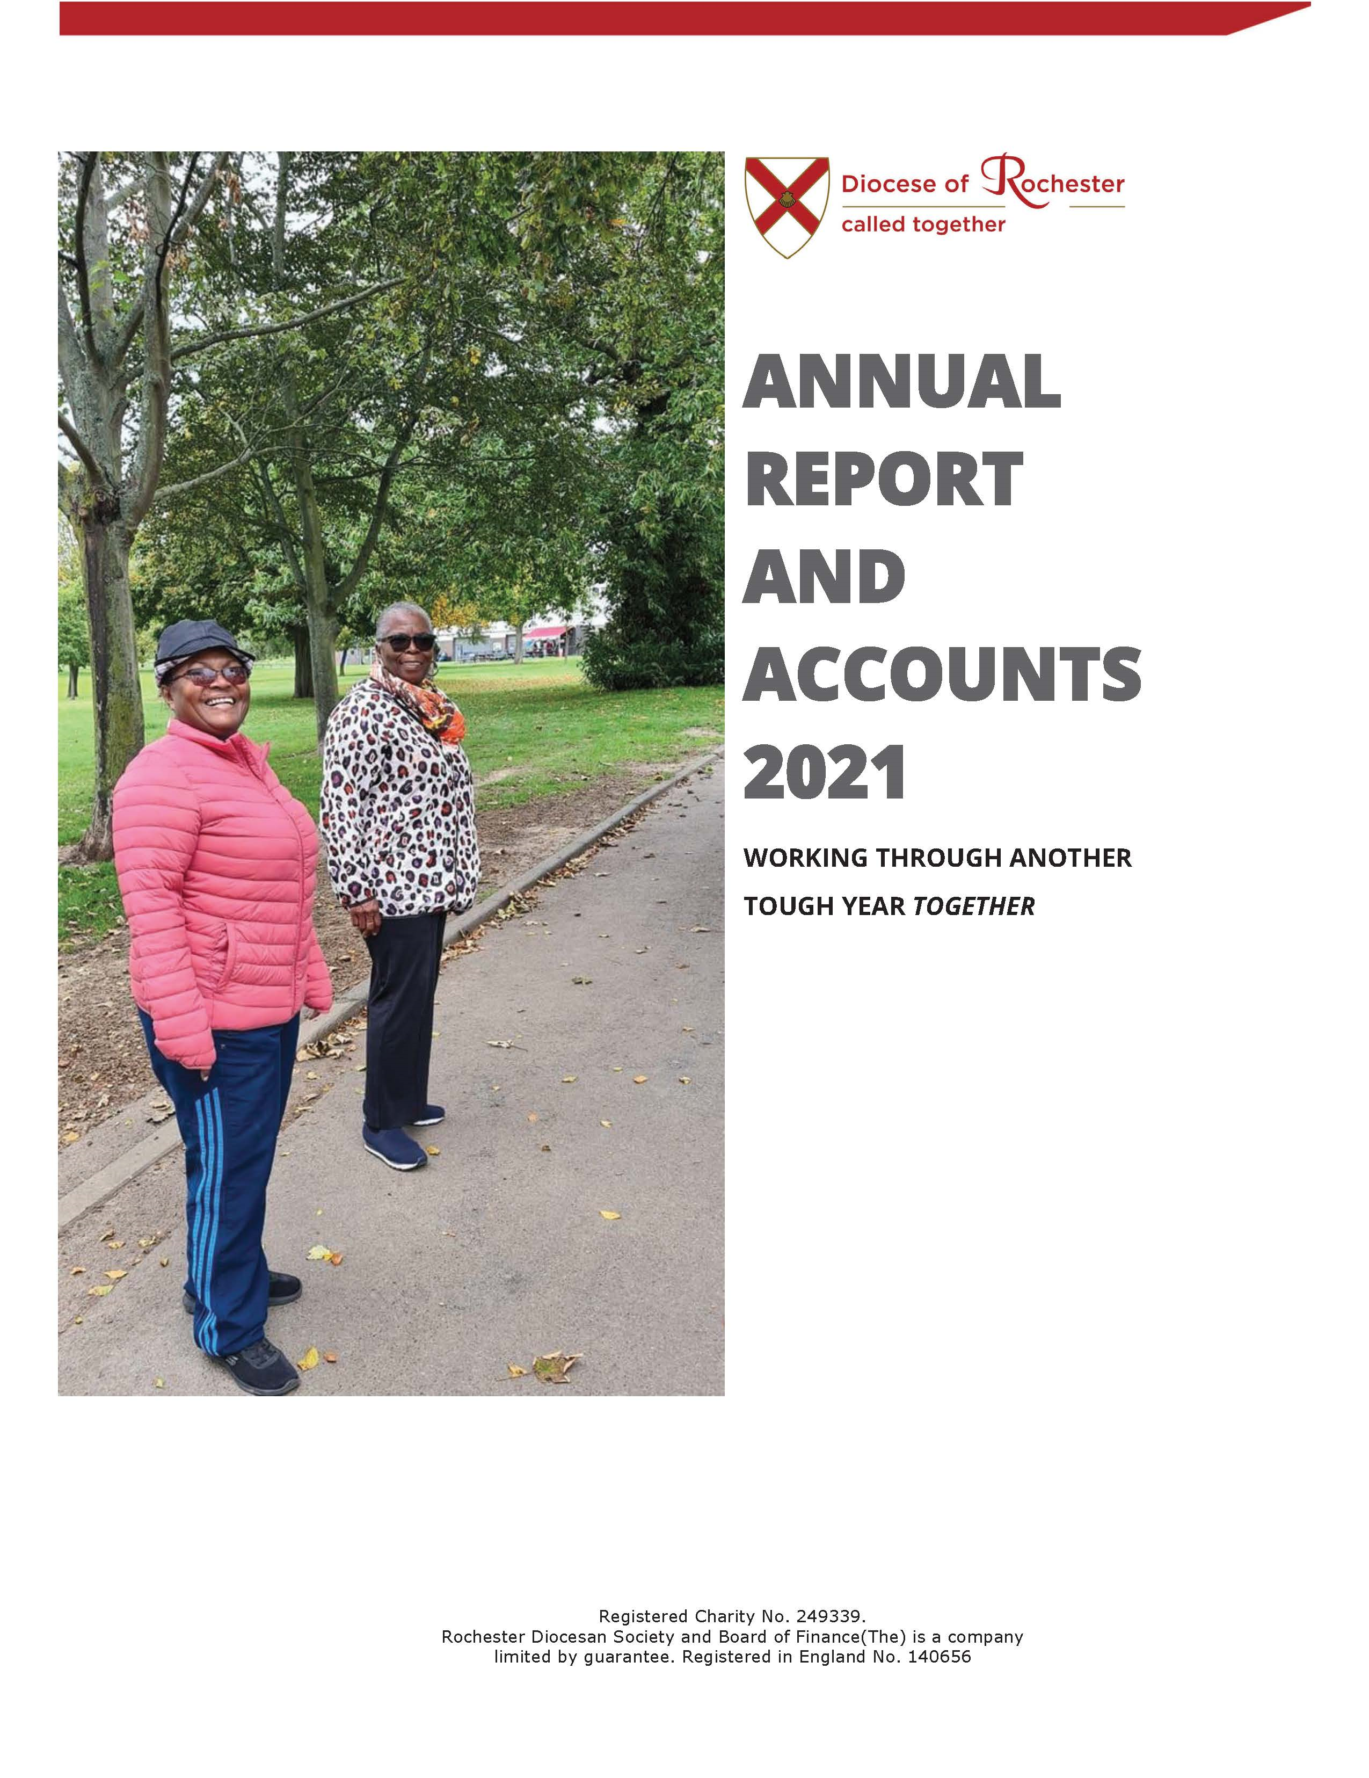
https://www.rochester.anglican.org/about-us/annual-report-and-accounts/

Slide 4
Context
Working towards a financially sustainable model of mission for the Diocese.
This should entail progressive narrowing of the gap between income and expenditure to steady state but should include targeted investment.
Budget continues to be impacted by the Covid-19 pandemic and the Cost of Living crisis.
Importance of Indicative Offers system.

Slide 5
2022 Forecast
Forecast £1.64M v Budgeted deficit £1.54M
  Stipends and Staff Salaries increased by 2% in April 2022 compared to the 22 Budget 1% increase; additional cost of £84K.
Parish Offers 2022 forecast £7.75M (-£500K on 22B of £8.25M)
  21A: £7.88M
  20A: £8.39M
  19A: £8.79M*
To July 2022, fall of 10.4% on 2019 levels compared to 8.1% average CofE.
  *after DBF Fees

Slide 6
Hardship Grants for Clergy 2022
£300 per clergy household offered March 2022.
Funded by Designated Ministry and Mission Support Fund.
91 clergy households applied (out of 230 eligible)
£340 per clergy household offered October 2022.
Funded by £64k grant from Church Commissioners’ Ministry Hardship Fund.

Slide 7
Energy Support Costs Fund
Fund totalling £549k made available.
£125k Covid 19 Emergency fund repurposed.
£249k Grant from Church Commissioners.
£175k Release of historic gains on investments through adoption of Total Return approach.

Slide 8
Energy Support Costs Fund
Grant notification letters to parishes October 2022.
Grant allocation calculated on IMD and population – seeking to help those who need it most.
Complete the Energy Support Costs Fund form to apply up to the maximum grant offered in letter.
Closing date to apply 30th November 2022.
Further grants will be available for ‘Warm Spaces’.

Slide 9
CRF and DLF Interest Rate Increase
WEF 1 October 2022
Church Repair Fund Deposits - 1.5%
Diocesan Loan Fund Deposits - 1.75%

Slide 10
2023 Budget
The 2023 Budget for the Common Fund being presented to Diocesan Synod is a deficit of £1.49M.
This compares to the 2022 Budget of £1.54M and the latest 2022 Forecast deficit of £1.64M.
The Financial Strategy plan is to move post Covid-19 to a sustainable financial position for the Common Fund.
Recovery of Parish Offers with DBF Fees is critical (81% of income).

Slide 11
Budget 2023
Budget (£M) | 2022F | 2023B
Parish Offers | 7,750 | 8,000
DBF Fees | 450 | 450
Other* | 1,707 | 2,002
Total Income | 9,907 | 10,452
Clergy stipend & pension | 5,798 | 5,824
Vacancy rate | 5.4% | 6.0%
Curates stipend & pension | 884 | 884
Other Expenditure | 4,862 | 5,237
Total Expenditure | 11,544 | 11,945
Budgeted Surplus/(Deficit) | (1,637) | (1,493)
Notes:
Other income
Property income £1,079k
Investment income £762k
Grants & donations £151k
Professional fees £10k
Increase mainly due to higher investment and property income anticipated in 2023.

Slide 12
Key Assumptions
2023 Parish Offers of £8.00M, compared to 2022 Forecast of £7.75M, 2021 Actual of £7.88M and the pre-Covid-19 level of £7.79M (after c£0.4M of DBF Fees retained by parishes)
  - Anticipates recovering parish contributions as churches return towards a steady state.
Average stipendiary clergy posts in 2023 of 160 with a 6% vacancy rate, compared to the 2022 current level of 165 (2021A: 174), with vacancies of 5.4%.

Slide 13
Key Assumptions cont’d
Diocesan Office staff employed 23 Budget FTEs 47.4 (2022B: 53.5; 2021A: 49.7; 2020A 48.6)
  - Staffing has been contained at a time of increasing regulatory requirements.
The Diocesan Office headcount now includes 5.8 FTE staff (2022B: 12) on the DBF payroll who are not funded by the Common Fund (inc. Generous Giving Officer)
Parsonage repair and maintenance is maintained at 2022’s budgeted level of £750K (including insurance)
  - £500K additional work budgeted for 2023 for major capital parsonage expenditure

Slide 14
Liquidity/ Going Concern
The 2023 budget forecasts the Common Fund will reduce to £3.7M by the end of 2023. This is below the policy of a minimum of £5M and excludes the proportion of any fall in market investments which currently stands at c£1m
  - A time where reserves are needed to be used.
Projected cash balance at 31 December 2023 of £3.8M, which compares to the liquidity policy minimum of £5.25M.
Net cash outflow of £2.9M projected for 2023.
£7.8M proceeds from property disposals (including Upper Beckenham for c£4.5M which will be re-invested in market investments).
£1.6M expenditure on property additions and capital expenditure and £2.2M on projects.

Slide 15
Cashflow 2023
Cashflow (£K) | 2023B
Operating Deficit on Common Fund (before property capitalisations) | (1,493)
Capitalised property expenditure | (250)
Net Cashflow on Common Fund | (1,743)
Property Disposals | 7,813
Property Additions | (1,625)
Project Capital Expenditure | (2,126)
Investment in Market Portfolio | (4,500)
Other Restricted Expenditure/Contingency | (750)
Net Cash Outflow | (2,931)
Cash b/f (forecast 1/1) | 6,799
Cash c/f (31/12) | 3,868

Slide 16
Concluding Remarks
Budget continues to be impacted by the Covid-19 pandemic and the Cost of Living Crisis.
Actions in last three years to manage our financial situation together, together with national assistance, provides confidence in ability to contain deficit.
Our worst case is fundable, if necessary.
We seek a financially sustainable model of mission for the Diocese going forward.

Slide 17
QUESTIONS

Slide 18
GENEROUS GIVING

Slide 19
Generous Giving
Update on Parish Giving Scheme
Digital giving update
Questions

Slide 20


Number of parishes signed up: 24
Donations in 2022 to date: £111,002
Average weekly gift (ex gift aid): £27.55
Average weekly gift, Diocese: £16.00

Slide 21
Annual Inflationary Increase – 90% are agreeing to increase
Facility for one off donations coming

Slide 22
Digital Giving
Total donations/ 2021 £108,769
payments 2020 £78,497
2019 £26,775
No. transactions 2021 8,400
2020 4,624
2019 1,819
Churches with 2021 66 (31%)
Active accounts 2020 65 (30%)
2019 31 (14%)

Slide 23
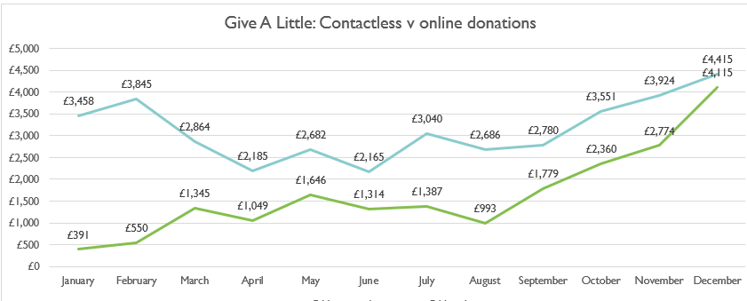
Digital Giving

Slide 24
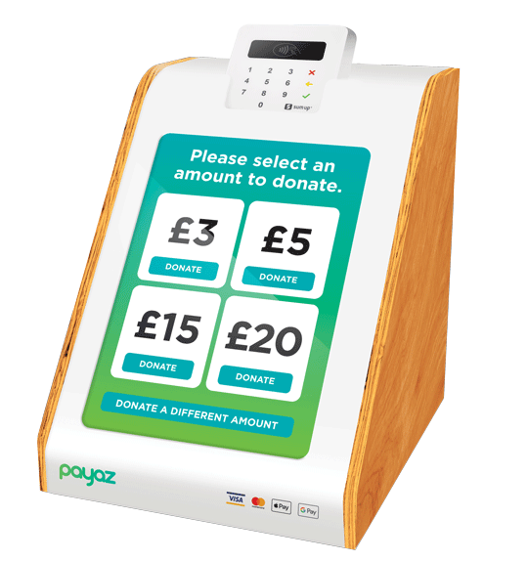
Training opportunity
Wednesday 7 December, 2.00pm
Thursday 8 December, 7.00pm
By Zoom

Slide 25
QUESTIONS

Slide 26
Liz Mullins
Generous Giving Adviser
liz.mullins@rochester.anglican.org
07917 739924

Slide 27
INDICATIVE OFFERS

Slide 28
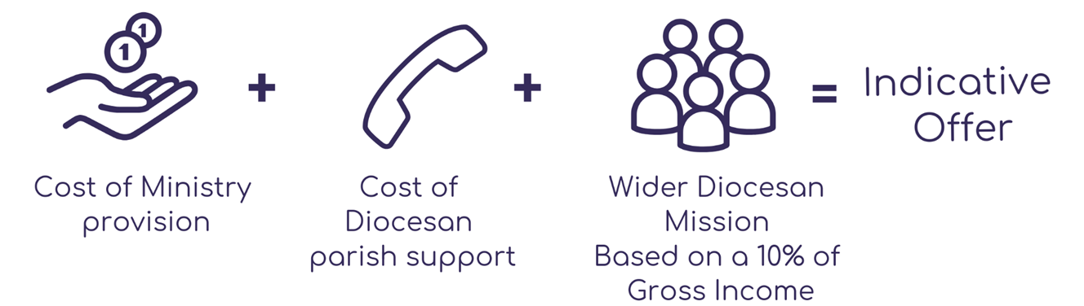
Indicative Offer

Slide 29
Indicative Offer System Review
Wider mission now calculated as 10% of gross income from prior year as reported on annual Finance Returns.
Removed all minor adjustments from IO calculation e.g. for associated costs. Benefice can adjust themselves when considering their offer.
10% of unrestricted legacies in year of gift (not smoothed as before).
Gross income cap removed but still provided as a guide for low income benefices.

Slide 30
Support Cost for Benefices – 2023
Ministry Cost (Full-time Incumbent)* £45,775
Diocesan Support Costs (2022: £12,147) £11,541
£57,316
Ministry Cost and Diocesan Support Costs £57K
Average contribution required to cover costs of
Future Ministry, Wider Diocesan Mission and National CofE £15K
Net average contribution required to support parishes unable
to cover fully the cost of a Full-time Incumbent and Diocesan
Parish Support Costs £12K
Contribution required from a Benefice £84k
*Clergy Stipend 3 months at £27,805 and 9 months at £29,195
Notes:
Future ministry £1,756k
Wider Diocesan Mission £350k
Contributions to National Church £434k
Total £2,540k split between 172 benefices is £14,767 per benefice

Slide 31
Parish Offer Process
Calculation of the Indicative Offer
  - By 31 October 2022
A formal resolution by the respective PCC(s) and submission of Parish Offer
- by end November, if possible
Scrutiny of Parish Offers by an Parish Offer Review Panel
  - early 2023
Preparation of regular and accurate reports to Bishop’s Council
Holding everyone accountable for the delivery of Parish Offers and the fair use of resources
The aspiration is that each benefice meets its combined Indicative Offer

Slide 32
QUESTIONS

Slide 33
TIMETABLE

Slide 34
Year-end Timetable
By end Nov 22 - Parish Offers
Fri 9 Dec 22 – Final Payments
Wed 28 Dec 22 – Final DD Collections
By Fri 6 Jan 23 - Statements on the DLF and
CRF accounts
Wed 11 Jan 23– Final date for Parish Offer update for Jan DD collection
By end Jan 23 – 4th Quarter DBF Fees

Slide 35
2023 Year-end Dates
By 31 May 23 – Report & Accounts/APCM/Finance Return
By 30 June 23 – Send Report & Accounts to Diocese
Early Oct 23 – Publish Indicative Offers

Slide 36
QUESTIONS

