Slide 1
Why your Parish Offer
matters

Slide 2

A shared endeavour
The cost of supporting day to day mission and ministry across the Diocese is a shared endeavour
Funded through The Common Fund - the common pot of money paid into by congregations across the Diocese
Supporting each other in this way is a demonstration of the shared sense of responsibility we have to everyone in our Church family, so all can flourish
Notes:
A shared endeavour In this Diocese, the cost of supporting and providing mission and ministry across the Diocese is a shared endeavour.
It is facilitated through The Common Fund - the common pot of money paid into by congregations across the Diocese through their Parish Offers – an amount determined by a parish or benefice.
Supporting each other in this way is a demonstration of the shared sense of responsibility we have to everyone in our Church family, so all can flourish.
Without these contributions, funding for clergy, their housing, mission and parish support would simply not be possible.
As we are reminded in 2 Corinthians, ‘Each of you must give as you have made up your mind, not regretfully or under compulsion, for God loves a cheerful giver.’ 2 Corinthians 9.

Slide 3
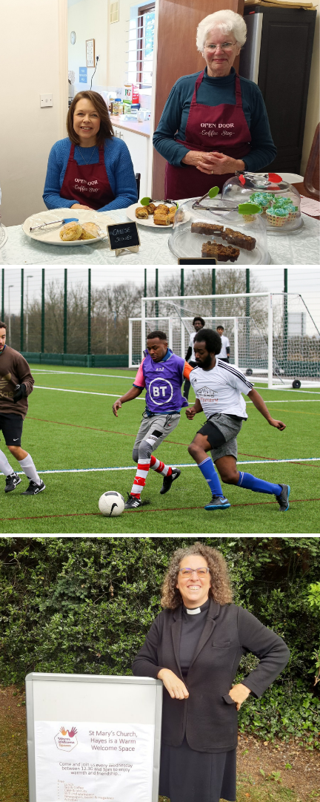
The Common Fund
Enables mission and ministry in churches and communities across the Diocese of Rochester, now and in the future
Ensures a Christian presence is maintained in every community
Provides a stable platform from which, together, we can bring about a Church where all can flourish and ‘have life in all its fulness’ as God intends
Notes:
The Common Fund The Common Fund aims to ensure a Christian presence can be maintained in every community as it supports the cost of mission and ministry in parishes across the diocese – now and in the future - no matter what their:
church tradition
local setting
financial situation
Nearly 75 per cent of the Common Fund is made up of Parish Offers.
It means your parish’s contribution is vital to the financial well-being of the whole diocesan family, and helps provides a stable platform from which, together, we can bring about a Church where all can flourish and ‘have life in all its fulness’ (John 10:10) as God intends.

Slide 4
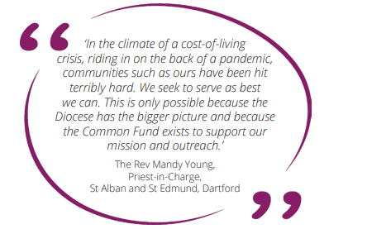
‘Though we are many we are one body’
Notes:
‘Though we are many we are one body’
Why is this the model used to finance and support mission and ministry?
The answer is that this collective response enables us to collectively ensure that the word of the Lord is spread throughout the Diocese, whatever the wealth of communities.
This is a quote from one parish who, although in a deprived area, has been able to continue its vital presence and ministry in the community, thanks to the Common Fund.
Giving into the Common Fund embodies biblical principles and the generosity at the heart of the first Christian communities too. We read in the New Testament how the early Christians showed a common concern for each other, sharing out their possessions.
‘All the believers were together and had everything in common. Selling their possessions and goods, they gave to anyone as he had need.’ (Acts 2:44-45)
As Christians, we understand too that as churches, we are part of one body in Christ, but dependent upon each other.
‘For just as the body is one and has many members, and all the members of the body, though many, are one body, so it is with Christ.’ (1 Corinthinians 12:12)

Slide 5
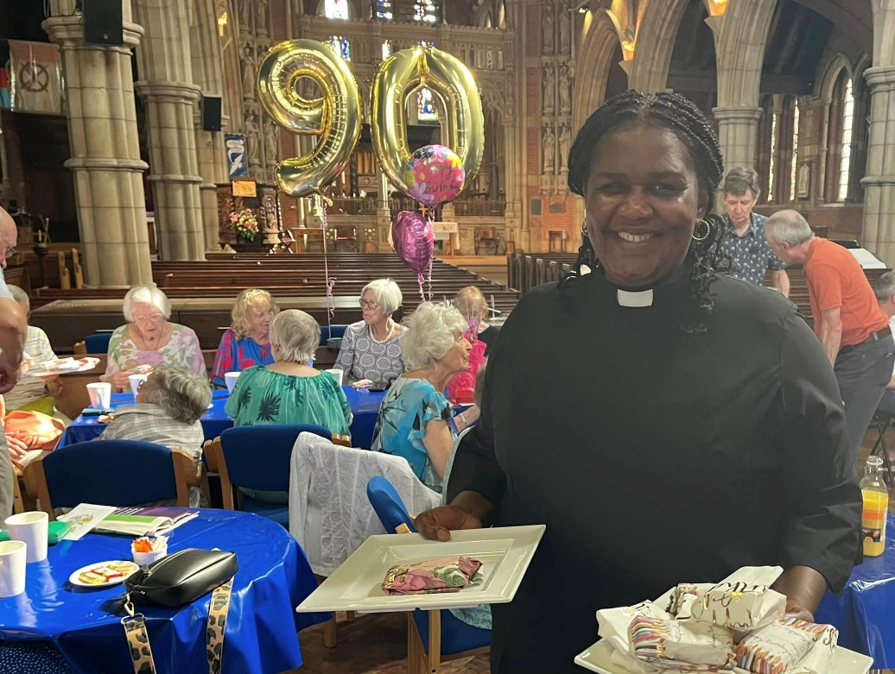
How the Common Fund supports: parish ministry
Allows a vicar to be placed in nearly every parish, paying for:
Stipend
Housing
Pension
Training
= £49,494
Notes:
How the Common Fund supports parish ministry The good news is that the money parishes contribute comes back to them in one form or another as ministry, mission or support services.
Indeed, the majority of the money into the Common Fund is spent on parish ministry. This allows a vicar to be placed in nearly every parish. It pays for things like
stipends (clergy pay)
pensions,
clergy housing
training for those already in post, as well as training future clergy.
£49,494 is how much it costs to pay for a full-time clergy-person, including employers NI, pension contributions and housing

Slide 6
Maintaining Parish Offer during a vacancy
‘We’re in vacancy, so why are we still be asked to pay for ministry?’
Costs are still incurred maintaining the parsonage
Assures potential clergy of the financial robustness and responsibility of the PCC
Provides ministry in other areas of the diocese where the resources are limited – one never knows when this could be your own parish
Notes:
Maintaining Parish Offer during a vacancy
‘We’re in vacancy, so why are we still be asked to pay for ministry?’
It’s an understandable question, however, there are several reasons why PCCs are asked to continue paying their Parish Offer in full during a vacancy.
The first is that the DBF still incurs costs maintaining the parsonage, and often a vacancy is the time when any significant works (new kitchens, bathrooms etc) are undertaken.
Secondly, potential clergy looking at the parish will often want to assure themselves of the financial robustness and responsibility of the PCC - the fact that the Parish Offer has been maintained is a good indication of this.
The third is that maintaining the Parish Offer during a vacancy allows for the provision of ministry in other areas of the diocese where the resources are limited.
Finally, as Christians, we support others, knowing that at some point in the future we ourselves may need supporting - this is the most compelling reason and goes to the heart of who and what we are called to be as part of the body of Christ.

Slide 7
How the Common Fund supports: local mission
Ensures a parish can serve its community whether the church is large or small, wealthy or poor, more rural or urban by helping with:
Community projects
Work with children and young people
Training for lay ministry
Paying into the Common Fund is not a choice between supporting your local mission over something else.
Notes:
How the Common Fund supports: local mission The money is also used to support local mission and outreach, for example through:
helping facilitate initiatives such as community projects
work with children and young people
training for lay ministry
This ensures a parish can serve its community and enable encounters with God whether the church is large or small, wealthy or poor, more rural or urban.
It means that paying into the Common Fund should not be seen as a choice between supporting your local mission or church building over something else.
Rather your local mission – your church’s presence - is supported through the generous giving of all parishes into the Common Fund.

Slide 8

How the Common Fund supports: Parish support
Safeguarding, HR, and governance
Legal advice and Communications
Advice on the care and development of church buildings
Guidance on fundraising and giving, or bringing in external funding for projects
Notes:
Money from the Common Fund additionally pays for the central services provided by the support teams at the Diocesan Office.
This includes support with:
Safeguarding, HR, and governance
Legal advice and Communications
Advice on the care and development of church buildings
Guidance on fundraising and giving, or bringing in external funding for projects
Diocesan Office colleagues help parishes maintain and grow their presence in the community, as well as meet their statutory responsibilities.

Slide 9
Why your Parish Offer is so vital
Notes:
The Parish Offer is a gift by a parish or benefice into the Common Fund, with each parish or benefice able to determine the amount it will contribute.
In 2025, there was a 2.5 per cent increase in Parish Offers over those made in 2024 – thank you!
Despite this, as this bar graph shows, Parish Offers do not cover the expenditure needed out of the Common Fund to cover day to day mission and ministry cost.
The shortfall has to be paid for out of funds generated by the Diocesan Board of Finance through:
Reserves
Strategic development fund and parish development grants
Other externally generated income
This subsidy is not sustainable long term which is why every Parish Offer is vital to help start closing this gap
In 2026, to meet the budget approved by Bishop’s Council – a 5 per cent increase in Parish Offers will need to be seen.

Slide 10
A reducing deficit
The diocese’s operating deficit has been gradually reducing.
Despite the ongoing invest in parish ministry,
2026 sees the lowest deficit for several years
£670, 000 deficit = the lowest for many years
Notes:
It’s important to note that Diocesan Team has been working hard over several years to reduce the operating deficit.
2026 will see a £670K deficit, the lowest for many years.
This is against a backdrop of investment in frontline ministry and a commitment to maintain the overall number of clergy in the diocese.

Slide 11
A budget investing in parishes
This year’s diocesan budget represents an additional £1m being invested in parochial ministry:
10% increase in clergy stipends
Additional £200k for maintenance of clergy properties
8 new curates starting their ministry in July 2026
Proactive work to reduction the clergy vacancy rate
Notes:
The budget approved for 2026 – despite being impacted by the recommendations of the national church’s Diocesan Finance Review – will represent an additional £1 million in parish ministry thanks to the following measures:
10% increase in clergy stipends
Additional £200k for maintenance of clergy properties
8 new curates starting their ministry in July 2026
Proactive work to reduce the clergy vacancy rate

Slide 12
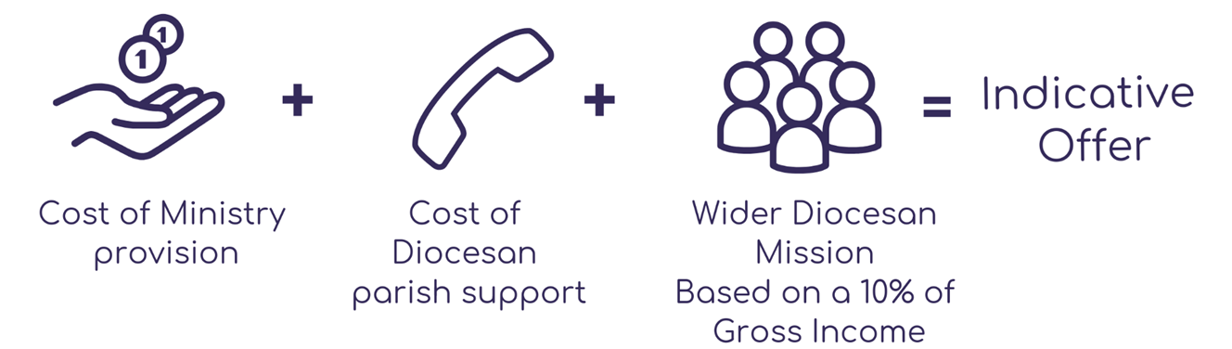
Each parish’s ability to contribute is different
Notes:
Each parish’s contribution into the Common Fund is vital but it is recognised that each parish’s ability to contribute is different.
To help parishes consider what they might give, each is provided with an Indicative Offer.
This is simply a guide figure and not a demand.
It is made up of three elements:
Cost of direct ministry - based on the number of full-time equivalent clergy in the parish or benefice
A share of central support costs
A contribution to wider diocesan mission, calculated as 10% of unrestricted income – this includes curate costs, training of clergy and ordinands youth and children ministry support, community engagement, contribution to the national church’s newly established Ministry Training Fund.

Slide 13
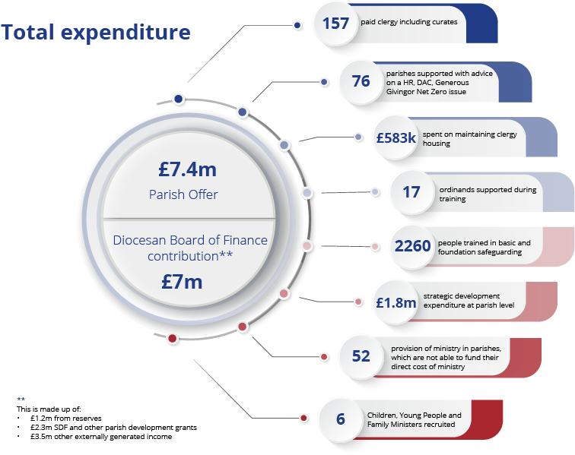
The BIG impact of your Parish Offer
Notes:
Thanks to the contribution of parishes like yours, and in partnership with the Diocesan Board of Finance, last year, the following was made possible:
157 paid clergy, including curates, supported
17 ordinands supported during training
£583,000 spent on maintaining clergy housing
6 Children, Young People and Family Ministers recruited, and 25 young leaders trained and successfully serving in their parishes
76 parishes supported with HR DAC, Generous Giving matters
So much would not be able to happen without the bedrock of the Common Fund, which is why a continued rise in contributions is so important.

Slide 14
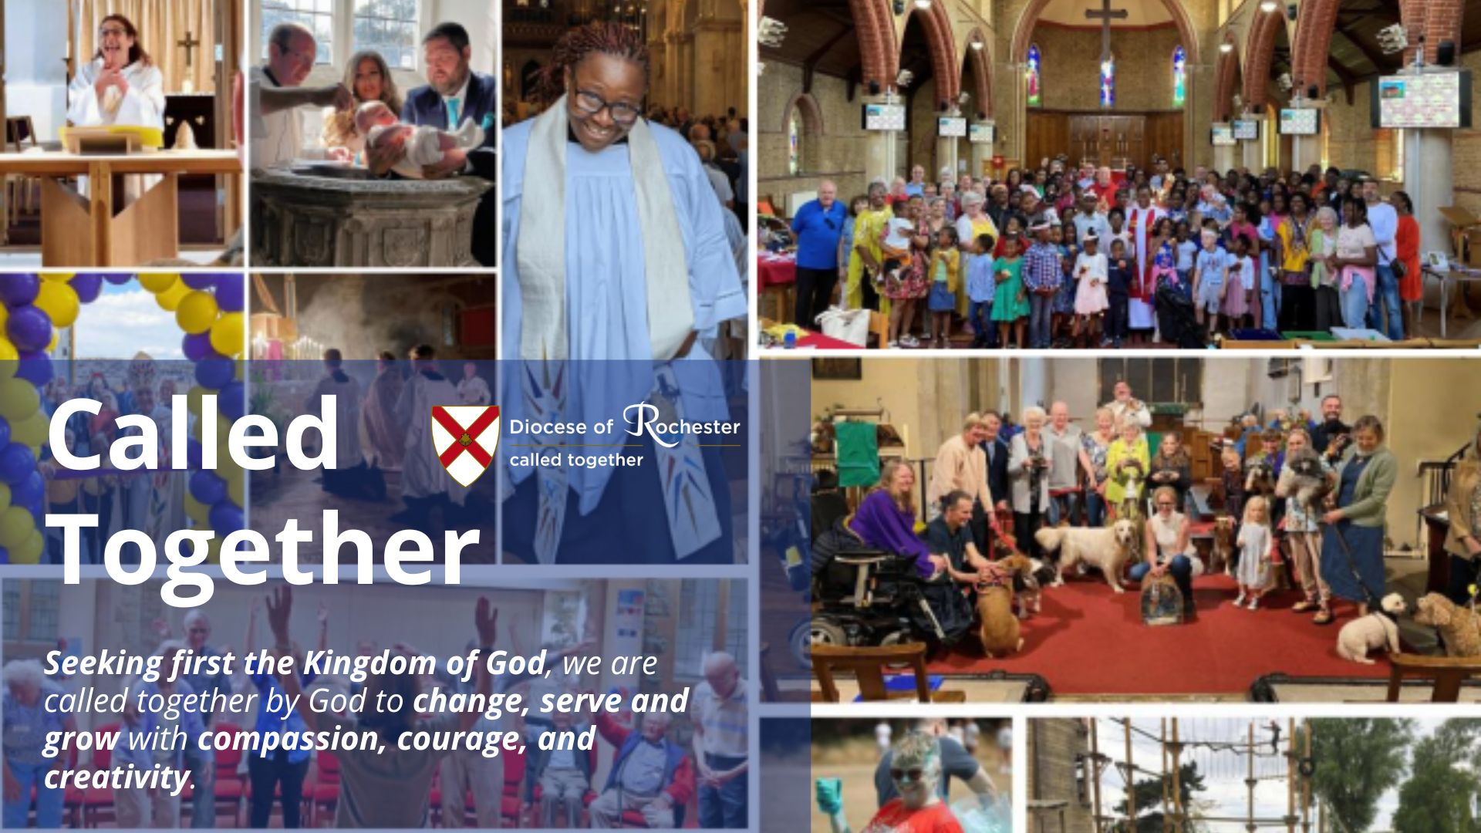
Seeking first the Kingdom of God together
Notes:
This year it was also wonderful to announce that the Diocese of Rochester had been awarded nearly £11 million by the national church in support of the shared Called Together vision.
This funding - which is in addition to the expenditure on parish ministry already funded by the Common Fund - will support the nine-year Called Together programme of work, which seeks to grow missional churches, with missional leaders and missional disciples.
This is direct investment in parishes, but without the bedrock of the Common Fund and your Parish Offers supporting day to day running costs none of it will be possible
THANK YOU for considering your Parish Offer so prayerfully, realistically and generously.
Whatever you are able to offer, it will be greatly valued.

Slide 15
Thank you for prayerfully and generously considering your Parish Offer
Notes:
THANK YOU for considering your Parish Offer so prayerfully, realistically and generously.
Whatever you are able to offer, it will be greatly valued.

